Slide 1

Real-time Epileptic Seizure Detection Using EEG and Machine Learning
By: Khushbakht Zia

Slide 2
Introduction
Epilepsy is a neurological disorder marked by recurrent seizures.
EEG (Electroencephalography) monitors brain activity to detect seizure patterns.
This project uses machine learning to automate seizure detection from EEG signals.
Goal: Automate seizure detection using ML on EEG signals.

Slide 3
Objectives
Analyze EEG data from epileptic patients.
Preprocess data for better ML performance.
Train and evaluate Random Forest, XGBoost, LightGBM.
Compare models using Accuracy, F1-score, Training Time.

Slide 4
Dataset Overview
Source: AUBMC (2014–2015), 6 patients, 35 seizures.
21 EEG channels, 500 Hz sampling rate.
Formats: EDF, .npy, .mat.
Seizure types: Complex Partial, Electrographic, Video-detected.
Normal: 3895s (balanced dataset).

Slide 5
Exploratory Data Analysis
Class Imbalance: Normal > Seizure.
EEG Visuals: Seizures show spikes/rhythms.
Boxplots/t-SNE: Show class separability.
Guided preprocessing & model choice.

Slide 6
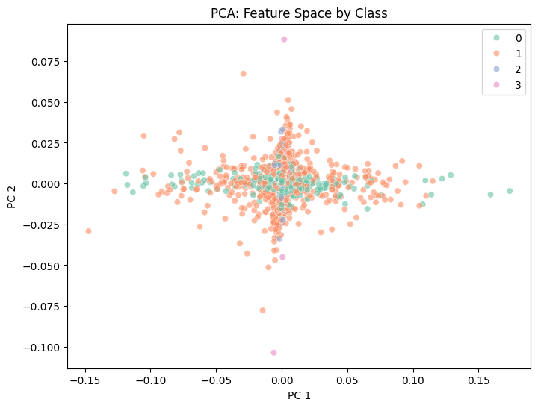
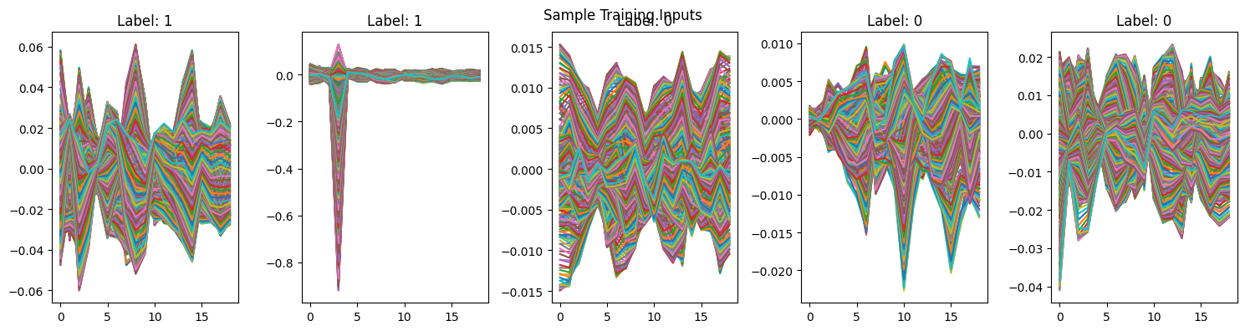
Data Visualizations
Figure 1: Visualization 1: Dimensionality Reduction Class Separation
Figure 2: Visualization 2: Visualize Sample Signals

Slide 7
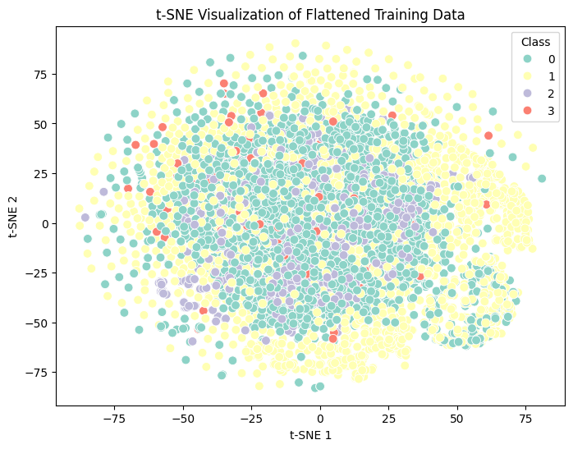
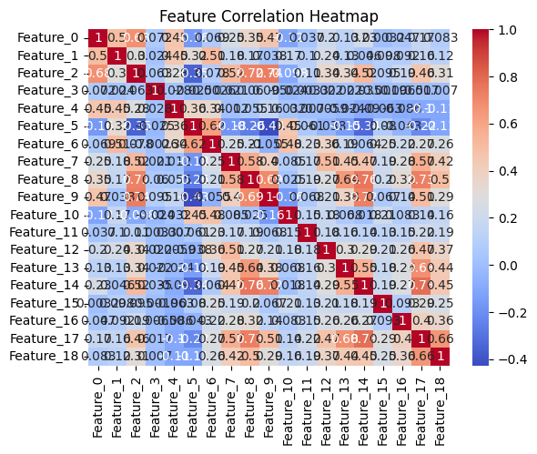
Figure 3: Visualization 3: Heatmap of Feature Correlations
Figure 4: Visualization 4: t-SNE Visualization of Raw Features

Slide 8
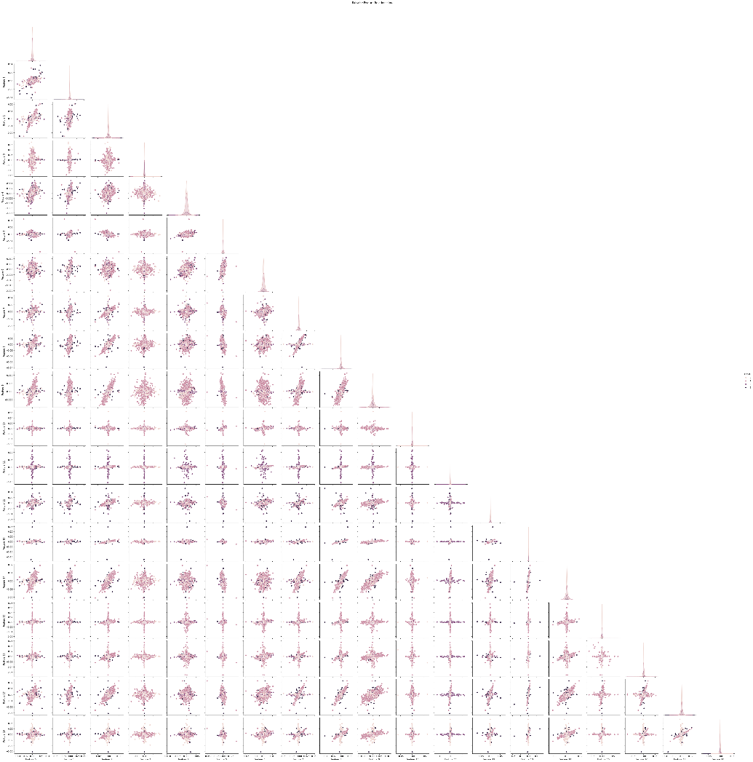
Pairwise Feature Relationship
1. Scatterplots (Off-Diagonal)
These show how two features relate for each class:
If points of different colors (classes) cluster separately, it means those features are good at separating classes.
If all colors mix and overlap, those features don't help much for classification.
If you see a straight diagonal line of dots, the features may be highly correlated (one might be redundant).
Figure 5: Visualization 4: Pairwise Feature Relationships

Slide 9
Preprocessing
Variance Thresholding: Remove low-info features.
Standard Scaling: Normalize features.
SMOTE: Balance seizure class.

Slide 10
ML Models Used
Random Forest: Fast, low false positives.
XGBoost: High accuracy, best F1.
LightGBM: Efficient, scalable, competitive performance.

Slide 11
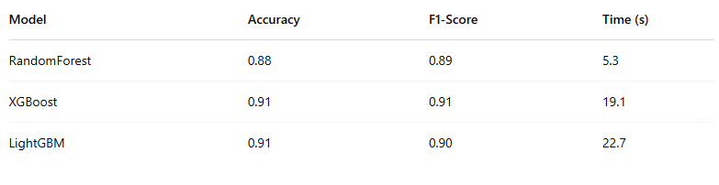
Model Comparison

Slide 12
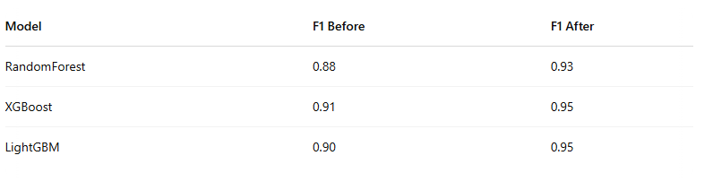
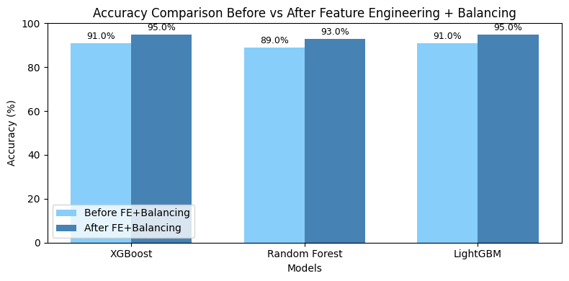
Impact of Preprocessing

Slide 13
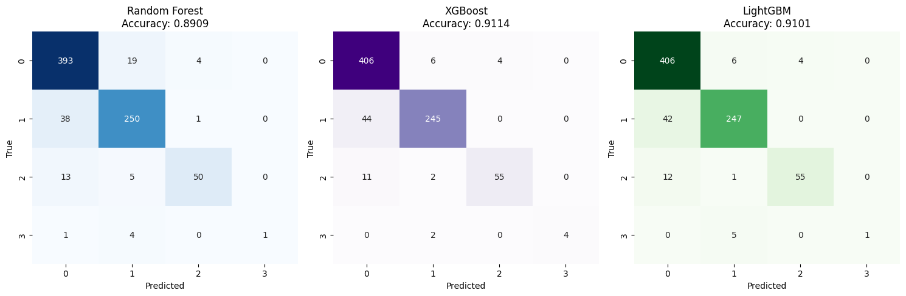
Confusion Matrix Insights
RF: Safe, low false positives, some misses.
XGB: High sensitivity, more false alarms.
LGBM: Balanced, fast, few false alerts.

Slide 14
Real-World Interpretation
RF: Best for cautious detection.
XGB: Best when seizure detection is critical.
LGBM: Best for speed and large-scale deployment.

Slide 15
Conclusion
Preprocessing (SMOTE, scaling) boosted model performance.
XGBoost and LightGBM: Highest F1 (0.95).
Future Work: Deep learning (CNNs, LSTMs), real-time deployment.

